Slide 1
AMC 8 Preparation
SDMC Fermat class
Instructor: David Balmin

Slide 2
Introduction
No calculators are allowed at AMC tests.
Approximately 10 first problems of each AMC 8 test can be solved without using pencil and paper.

Slide 3
Introduction
Visit http://amc.maa.org:
“AMC Archives” –> “AMC 8” –> “Brochure Sample Questions”
Publications -> “AMC 8 Math Club Package 2009” with the large collection of AMC problems and solutions.

Slide 4
Introduction
Practice to answer questions 1 through 15 of each test.
Try to solve these problems as fast as you can.
If you can quickly answer questions 1 through 15 correctly, concentrate on solving problems 16 through 25.

Slide 5
Focus
We will focus in this class on solving several selected AMC 8 problems that are instructive and cover different topics.
We will start with reviewing some math theory and methods that can help you solve AMC 8 test problems.

Slide 6
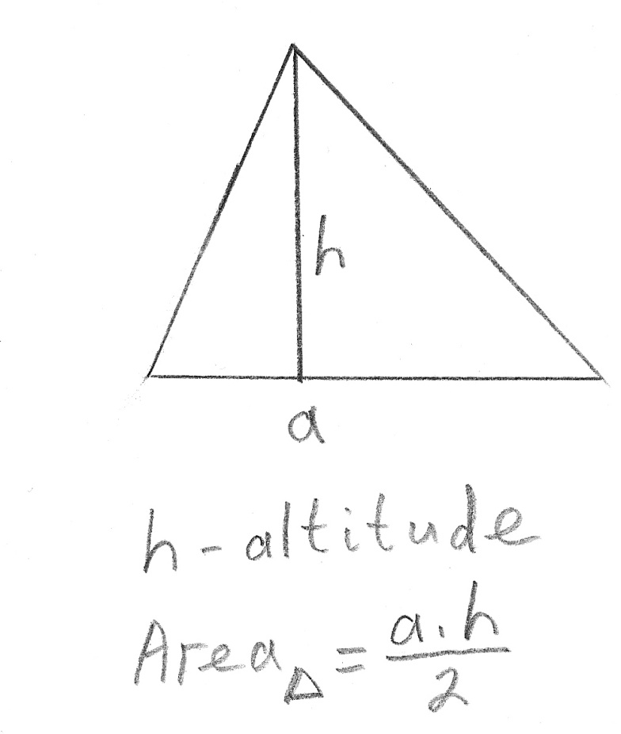
Triangles

Slide 7
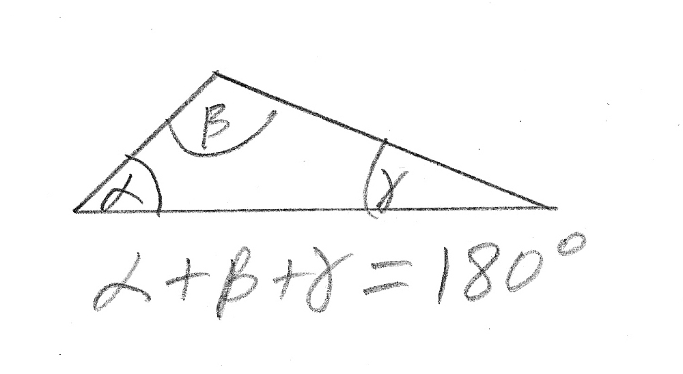
Triangles

Slide 8
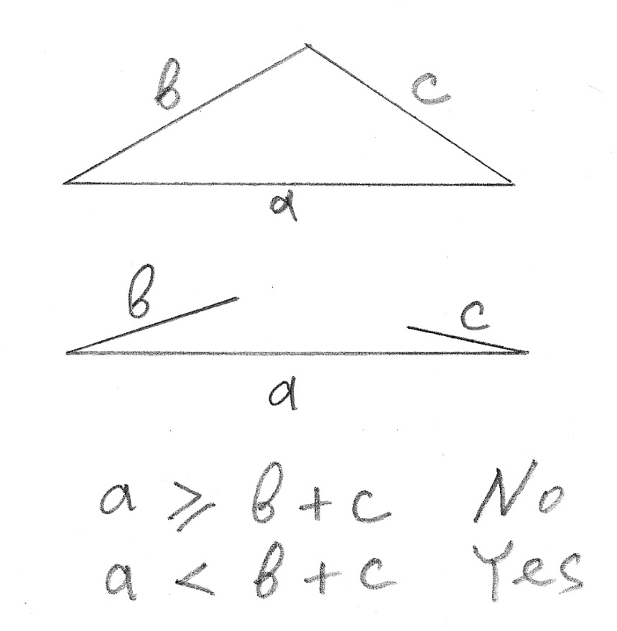
Triangle Inequality Theorem

Slide 9
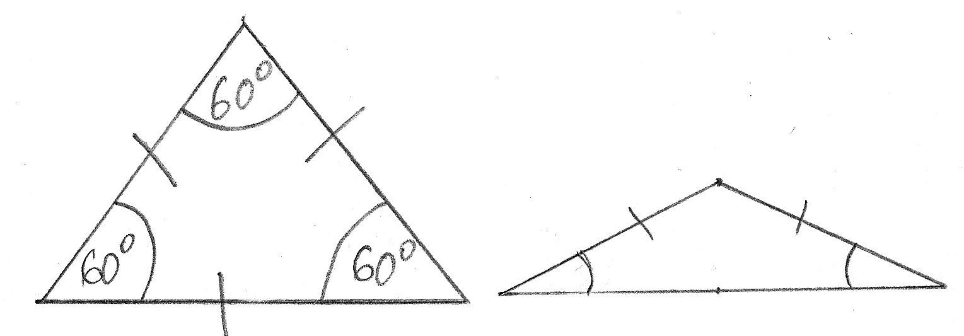
Equilateral and Isosceles Triangles

Slide 10
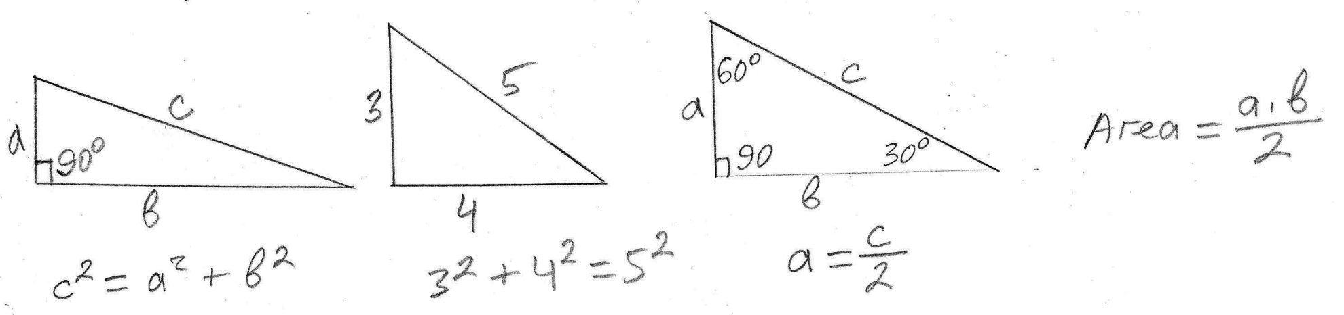
Right Triangles

Slide 11
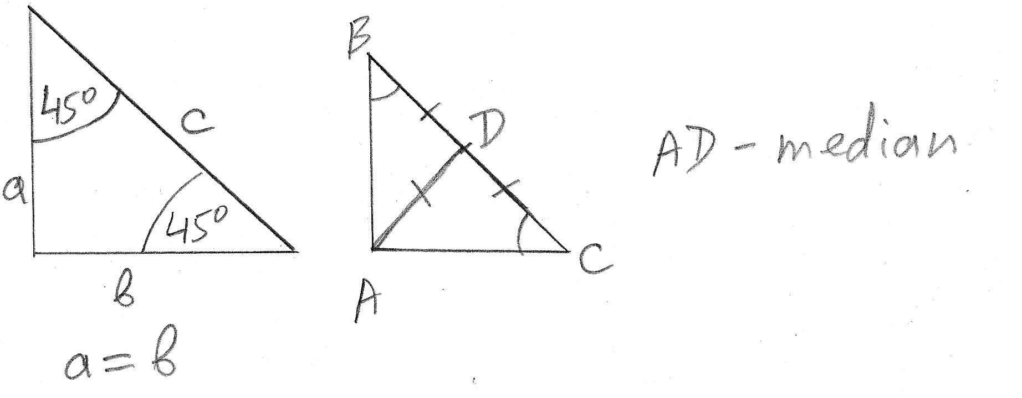
Right Triangles

Slide 12
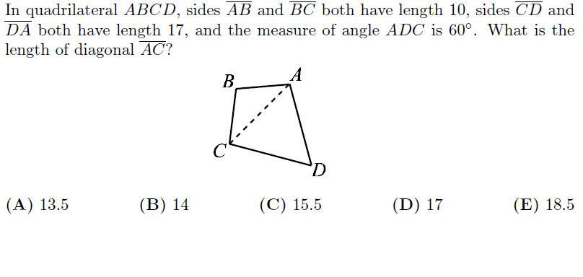
AMC 8 2005, Problem #9

Slide 13
AMC 8 2005, Problem #9
Triangle ACD is isosceles.
Therefore, angles ACD and ADC have equal measures.
Triangle ACD is equilateral (60-60-60).
The length of AC = 17.
Answer (D).

Slide 14
AMC 8 2005, Problem #9
Note: information that sides AB and BC both have length 10 is irrelevant and is not used in the solution of this problem.

Slide 15
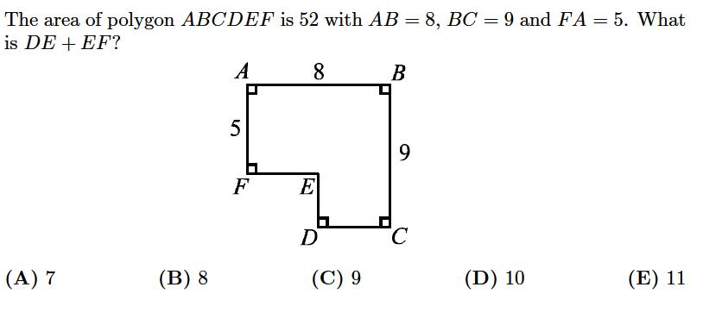
AMC 8 2005, Problem #13

Slide 16
AMC 8 2005, Problem #13
Draw the rectangle FEDG in the lower left corner of polygon FEDCEF.
The area of rectangle ABCG is 9*8 = 72.
The area of rectangle FEDG is 72 – 52 = 20.

Slide 17
AMC 8 2005, Problem #13
DE = FG = 9 -5 = 4.
EF*4 = 20.
EF = 5.
DE + EF = 4 + 5 = 9.
Answer: (C).

Slide 18
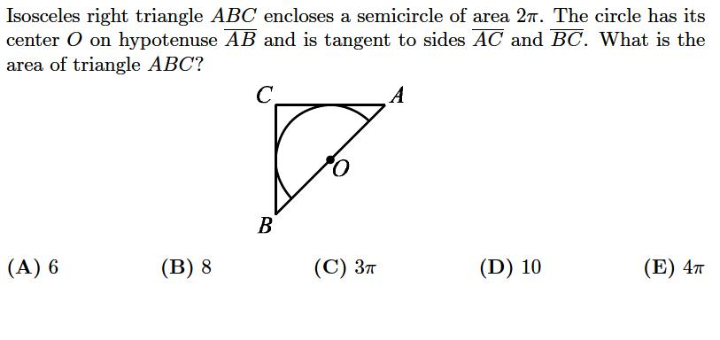
AMC 8 2005, Problem #23

Slide 19
AMC 8 2005, Problem #23
Draw full square ADBC and full circle inscribed in this square.
The area of the circle is 2*Pi * 2 = 4*Pi.
Then, the radius of the circle is 2.
Then, the side of square ADBC has length 4.
The area of square ADBC is 16.
The area of triangle ABC is 8.
Answer: (B).

Slide 20
Perimeter of a Triangle
Triangle ABC has side-lengths AB = 12, BC = 24, and AC = 18. Line segments BO and CO are bisectors of angles B and C of ∆ABC. Line segment MN goes through point O and is parallel to BC. What is the perimeter of ∆AMN?
(A) 27 (B) 30 (C) 33 (D) 36 (E) 42

Slide 21
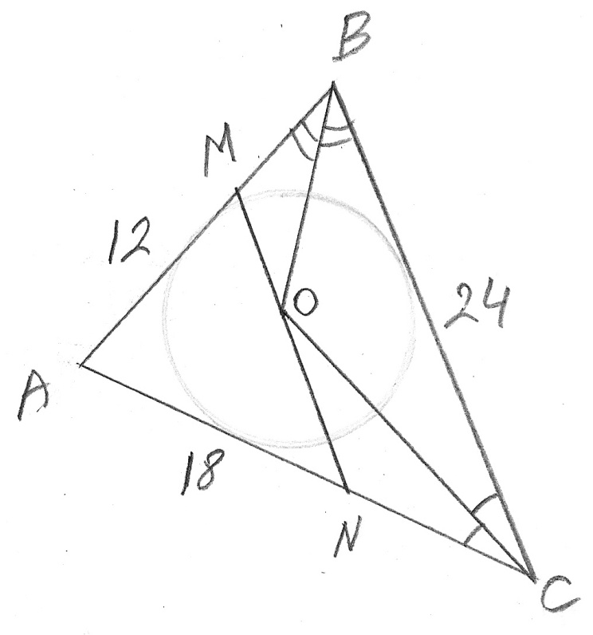
Perimeter of a Triangle

Slide 22
Perimeter of a Triangle
Hint: The alternate interior angles between two parallel lines and a transversal line have equal measures.
So, ∠MOB = ∠OBC.
So, ∠MOB = ∠MBO.

Slide 23
Perimeter of a Triangle
So, triangle OMB is isosceles.
MB = MO.
For the same reason, NC = NO.

Slide 24
Perimeter of a Triangle
The perimeter of ∆AMN is:
AM + AN + MN =
AM + AN + MO + ON =
= AB + AC =
= 12 + 18 = 30.
Answer: (B)

Slide 25
Perimeter of a Triangle
Note: the point of intersection of angle bisectors of a triangle is the “incenter” of that triangle.
Incenter is the center of the inscribed circle.

Slide 26
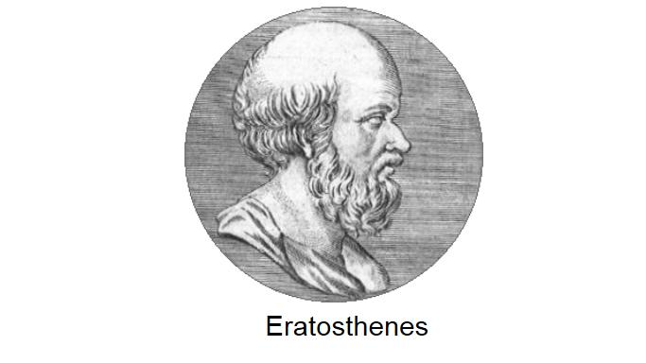
Eratosthenes

Slide 27
Eratosthenes
Circa 200 BC, the Greek mathematician Eratosthenes invented the brilliant method of measuring the circumference of Earth, based on his knowledge of geometry and astronomy.
His method is a good example of finding the “smart way” instead of the “hard way” to solve a difficult problem.

Slide 28
Eratosthenes
As shown in the diagram, he needed to measure the angle φ between the two radii of the Earth pointing to the cities Alexandria and Syene in Egypt.

Slide 29
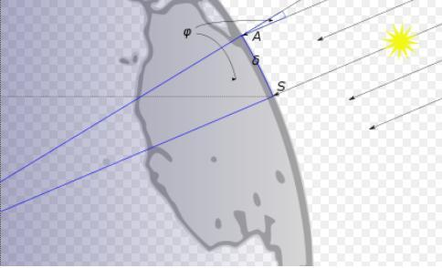
Eratosthenes

Slide 30
Eratosthenes
The direct (hard) way would have been to measure angle φ from the center of the Earth. ☹
But the smart way that Eratosthenes invented was to measure the same angle φ between the sun ray and the lighthouse in Alexandria at noon time on the day of summer solstice, when the Sun was at the zenith in Syene.

Slide 31
Eratosthenes
Using geometry of parallel lines, he calculated that the distance from Alexandria to Syene must be ≈ 7/360 of the total circumference of the Earth.

Slide 32
Eratosthenes
The measurement of the distance between Alexandria and Syene was based on the estimated average speed of a caravan of camels that traveled this distance.
It is generally believed that Eratosthenes' value corresponds to between 39,690 km and 46,620 km., which is now measured at 40,008 km. Eratosthenes result is surprisingly accurate.

Slide 33
Geometry on a Grid Problem
Assuming that the grids in both diagrams consist of straight lines that form squares of the same size, how can it be explained that the second figure has a hole?

Slide 34
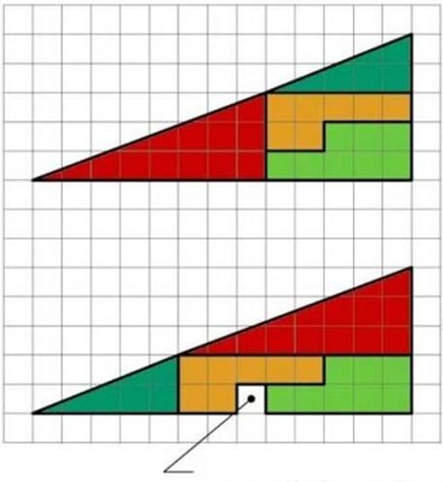
Geometry on a Grid Problem

Slide 35
Geometry on a Grid Problem
The composition of two hexagons in the first figure forms a rectangle with dimensions 5x3 = 15.
The composition of the same two hexagons in the second figure forms a rectangle with dimensions 8x2 = 16.
16 – 15 = 1 explains the extra square.

Slide 36
Geometry on a Grid Problem
The combined figures in the diagrams look like triangles, but they are not!
They are quadrilaterals.
Count squares along each horizontal and vertical side of all four parts inside each figure.

Slide 37
Geometry on a Grid Problem
All four geometrical shapes (except one extra square in the second figure) have the same dimensions in both diagrams.
It proves that the combined figures cannot be triangles. Otherwise, their areas would be equal which would make the existence of an extra square inside one of them impossible.

Slide 38
Probability
Experiment
Outcomes – Sample space
Probability of the desired event: P
The number of all possible outcomes: N
The number of distinct ways (outcomes) the desired event can occur: M
P = M / N

Slide 39
Probability – Example 1
Experiment: tossing a coin.
All possible outcomes: heads or tails.
The desired event: a coin landing on heads.
Probability of the desired event: 1/2.

Slide 40
Probability – Example 2
Experiment: throwing a dice with 6 faces.
All possible outcomes: numbers 1 through 6.
The desired event: an odd number.
Probability of the desired event: 3/6 = 1/2.

Slide 41
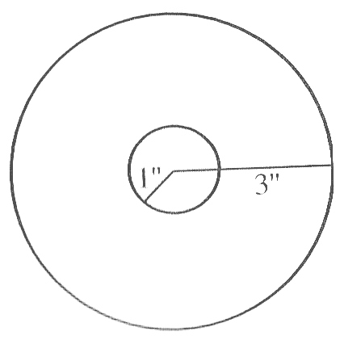
Probability – Example 3

Slide 42
Probability – Example 3
Experiment: target shooting.
All possible outcomes: hitting target anywhere inside the big circle.
The desired event: hitting target anywhere inside the small circle.
Probability of the desired event: Pi*1 / Pi*9 = 1/9.

Slide 43
Probability – Example 4
The probability of guessing the correct answer to any question of AMC 8 test is 1/5.
Probability can be perceived as the average frequency of the event in a long sequence of independent experiments.
So, the expected frequency of correctly guessed answers is 1 out of 5 answers (or 5 out of 25 answers).

Slide 44
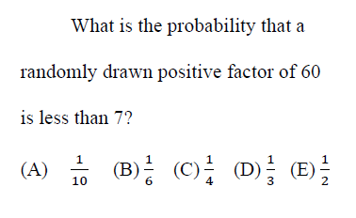
AMC 12A 2003, Problem #8

Slide 45
AMC 12A 2003, Problem #8
All factors of 60:
1, 2, 3, 4, 5, 6, 10, 12, 15, 20, 30, 60.
The number of all factors is 12.

Slide 46
AMC 12A 2003, Problem #8
The number of all factors that are less than 7 is 6.
The probability: 6/12 = 1/2.
Answer: (E).

Slide 47
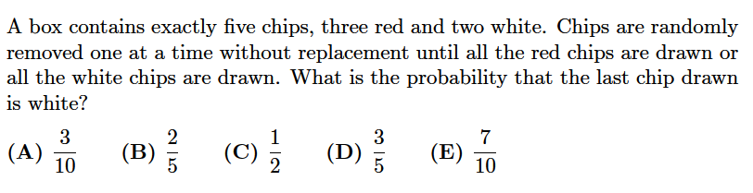
AMC 12 2001, Problem #11

Slide 48
AMC 12 2001, Problem #11
The drawings can stop at drawing #2, drawing #3, or, “worst case”, drawing #4.
Suppose that we complete all 5 drawings, regardless of the results of the first 4 drawings.
We can define two mutually-exclusive results of the first 4 drawings: A and B.

Slide 49
AMC 12 2001, Problem #11
Result A: all the white chips have been drawn during the first 4 drawings.
Result B: all the red chips have been drawn during the first 4 drawings.
Then, the question in this problem can be rephrased as:
“What is the probability of result A?”

Slide 50
AMC 12 2001, Problem #11
Result A is possible if and only if the remaining chip drawn in the 5th drawing is red.
Thus, the initial question in this problem can be further rephrased as:
“What is the probability that, as the result of all 5 drawings, the chip drawn in the 5th drawing is red?”

Slide 51
AMC 12 2001, Problem #11
Experiment: doing all 5 drawings.
All possible outcomes: any red or any white chip in drawing #5.
The desired event: any red chip in drawing #5.
Total number of possible outcomes: 5.
Total number of ways the desired event can occur: 3.

Slide 52
AMC 12 2001, Problem #11
The probability that a red chip is drawn in the 5th drawing is 3/5.
Answer: (D).

Slide 53
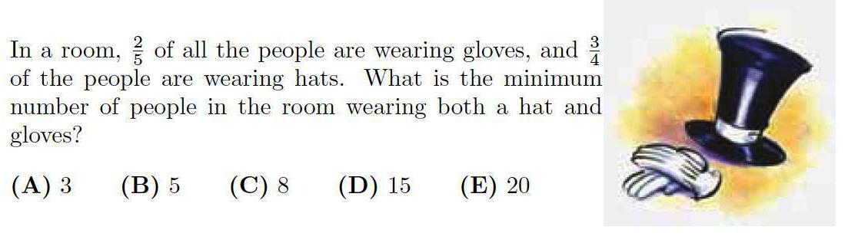
AMC 8 2010, Problem #20

Slide 54
AMC 8 2010, Problem #20
First of all, we need to calculate the minimum number of people in the room.
The fractions 2/5 and 3/4 correspond to the numbers of people wearing gloves and hats respectively.
The minimum number of people in the room equals the least common denominator of these two fractions: 20.

Slide 55
AMC 8 2010, Problem #20
Now, we can calculate the number of people wearing gloves, 20 * 2/5 = 8,
and the number of people wearing hats,
20 * 3/4 = 15.
We can use the “worst case” method to answer the question of the problem.

Slide 56
AMC 8 2010, Problem #20
In the “best case”, 8 people wear both gloves and a hat, 7 people wear hats and no gloves, and 5 people wear neither gloves nor hats.
However, in the “worst case”, 3 people must wear both gloves and a hat; then 5 people wear gloves and no hats, and 12 people wear hats and no gloves.
Answer: (A).

Slide 57
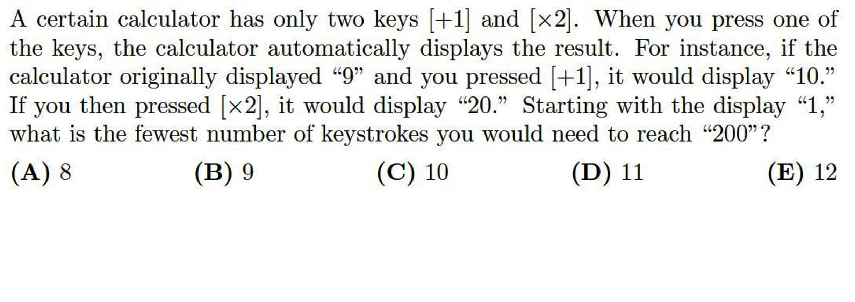
AMC 8 2005, Problem #24

Slide 58
AMC 8 2005, Problem #24
Hint: start from the end and work backward.
Since the only available operations are “+1” and “*2”, the reverse operations are “-1” and “/2”.

Slide 59
AMC 8 2005, Problem #24
Clearly, we want to divide 200 by 2 and continue to repeat this operation as long as the result numbers are even.
We get numbers 100, 50, 25.
Since 25 is odd, the only choice is to subtract 1. We get 24.
Now, we can start dividing numbers by 2 again. We get numbers 12, 6, 3.

Slide 60
AMC 8 2005, Problem #24
3 is odd. So, the last two reversed operations result in numbers 2 and 1.
Now, we can write the same numbers in the ascending order and count the forward operations: 1, 2, 3, 6, 12, 24, 25, 50, 100, 200.
The number of operations is 9.
Answer: (B)

Slide 61
AMC 8 2005, Problem #24
Prove that 8 operations suggested in answer (A) cannot result in 200.
If all 8 operations are “*2”:
2*2*2*2*2*2*2*2 = 256 > 200
If we replace any one operation “*2” with “+1”:
3*64 = 192 < 200

Slide 62
AMC 8 2005, Problem #24
5*32 = 160 < 200
9*16 = 144 < 200
17*8 = 136 < 200
33*4 = 132 < 200
65*2 = 130 < 200
It’s obvious that replacing one more “*2” operation with “+1” in any of these cases will only reduce the result.

Slide 63
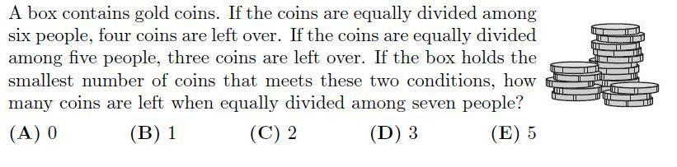
AMC 12A 2006, Problem #23

Slide 64
AMC 12A 2006, Problem #23
After dividing among 6 people, 4 coins are left. Add 2 coins to make the total divisible by 6.
After dividing among 5 people, 3 coins are left. Again, add 2 coins to make the total divisible by 5.
The LCM of 6 and 5 is 30.

Slide 65
AMC 12A 2006, Problem #23
The number of coins in the box is 30 - 2 = 28.
28 is divisible by 7.
Answer: (A).

Slide 66
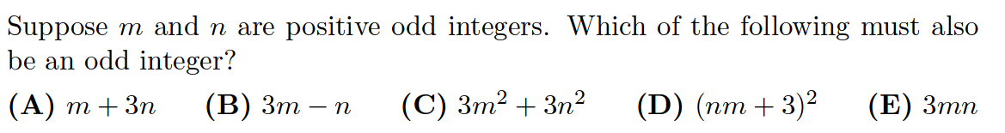
AMC 8 2005, Problem #8

Slide 67
AMC 8 2005, Problem #8
This is an example of how the multiple-choice answers can be used creatively.
Since we need to choose the formula that has odd values for all positive odd n and m, then one counter example for a given formula eliminates that formula.

Slide 68
AMC 8 2005, Problem #8
If we simply calculate each formula in A, B, C, D, and E for n = 1 and m = 1, then A, B, C, and D produce even numbers and can be eliminated.
Only the formula in answer E produces odd number that makes it the clear winner.
Answer: (E).

Slide 69
AMC 8 2005, Problem #8
Of course, it is not hard to solve this problem using the rules of math for odd and even numbers.
Whichever method works better for you during the test is fine, as long as it is correct.

